Slide 1
The Gaseous State of Matter
Chapter 12

Slide 2
Properties of Gases
Gases have an indefinite shape
Gases expand to fill their containers uniformly
Gases are compressible
Gases have low densities
air 0.0013 g/mL
water 1.00 g/mL
iron 7.9 g/mL
Gases diffuse uniformly throughout their containers to form homogeneous mixtures.
A gas exerts a pressure

Slide 3
Common units of pressure
101.325 kPa
= 760 mm Hg
= 760 torr
= 1 atm
= 30 in Hg
= 14.7psi

Slide 4
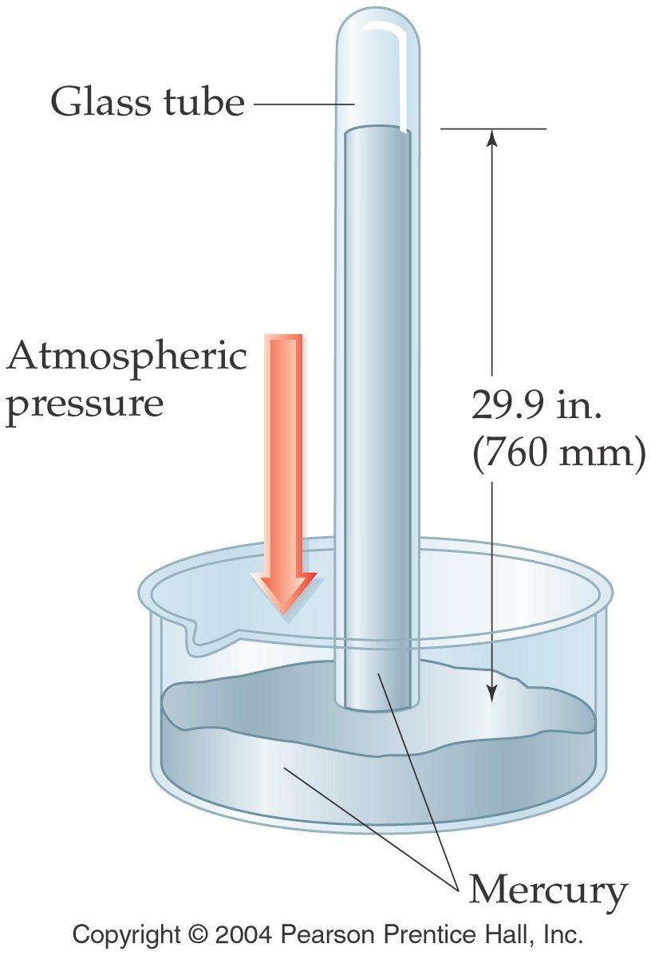

Slide 5
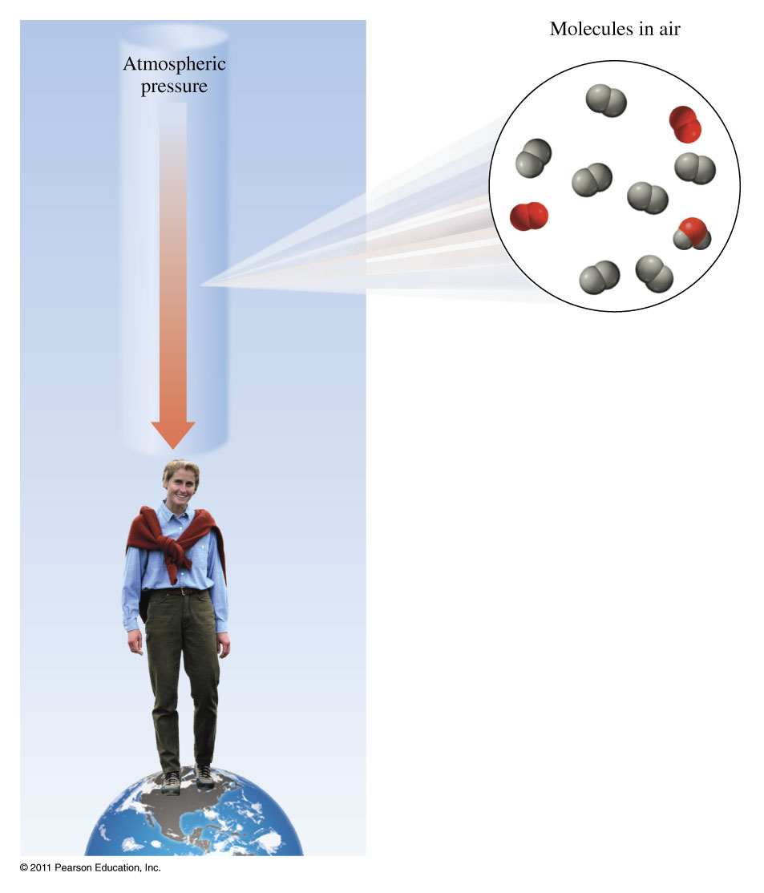

Slide 7
The atmospheric pressure at the summit of Mt. McKinley (Denali) is 606 mm Hg on a certain day. What is the pressure in atmospheres?

Slide 8
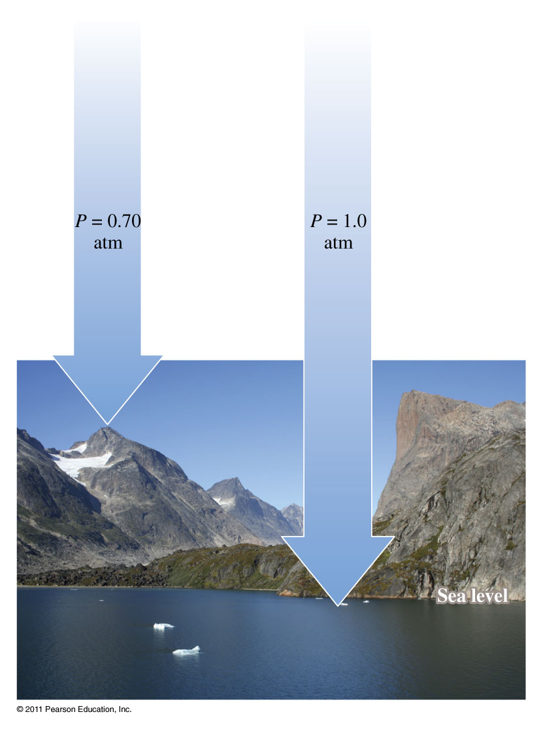
The atmospheric pressure at the summit of Mt. McKinley (Denali) is 606 mm Hg on a certain day. What is the pressure in atmospheres?

Slide 9
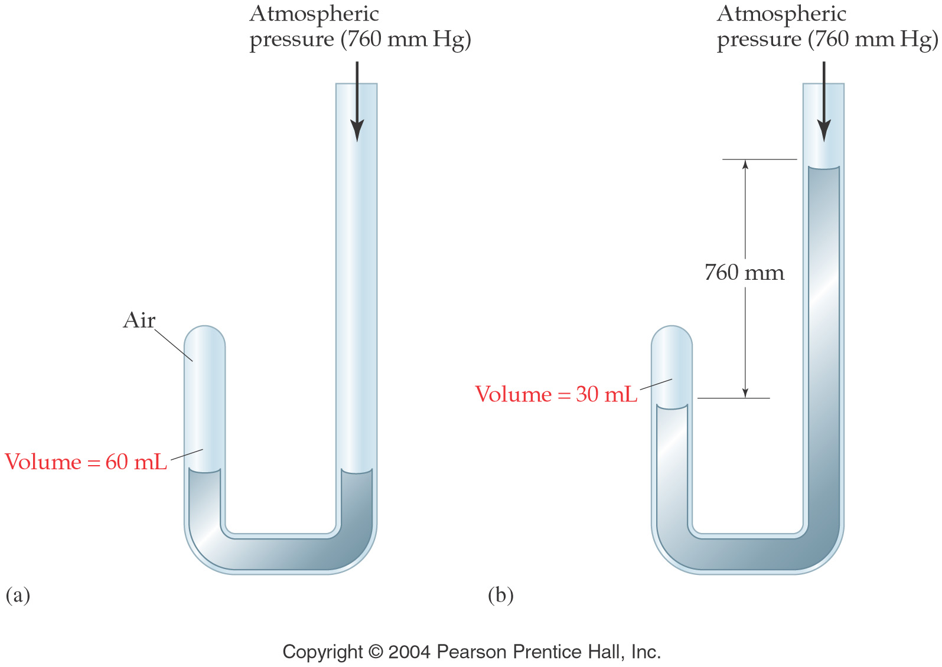

Slide 10
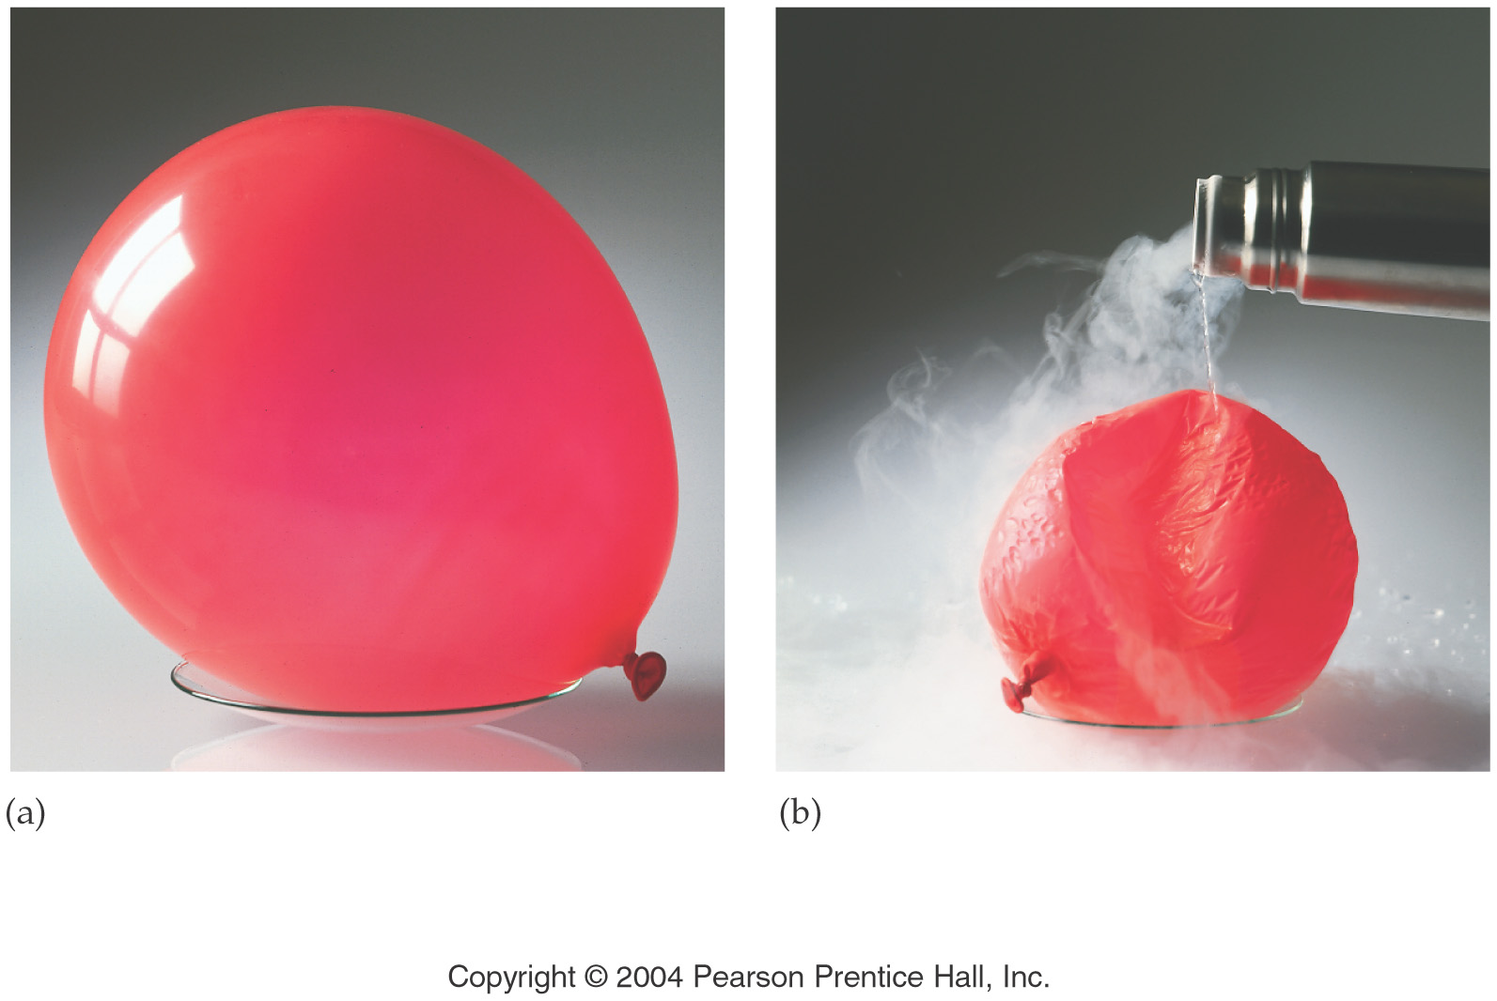

Slide 11
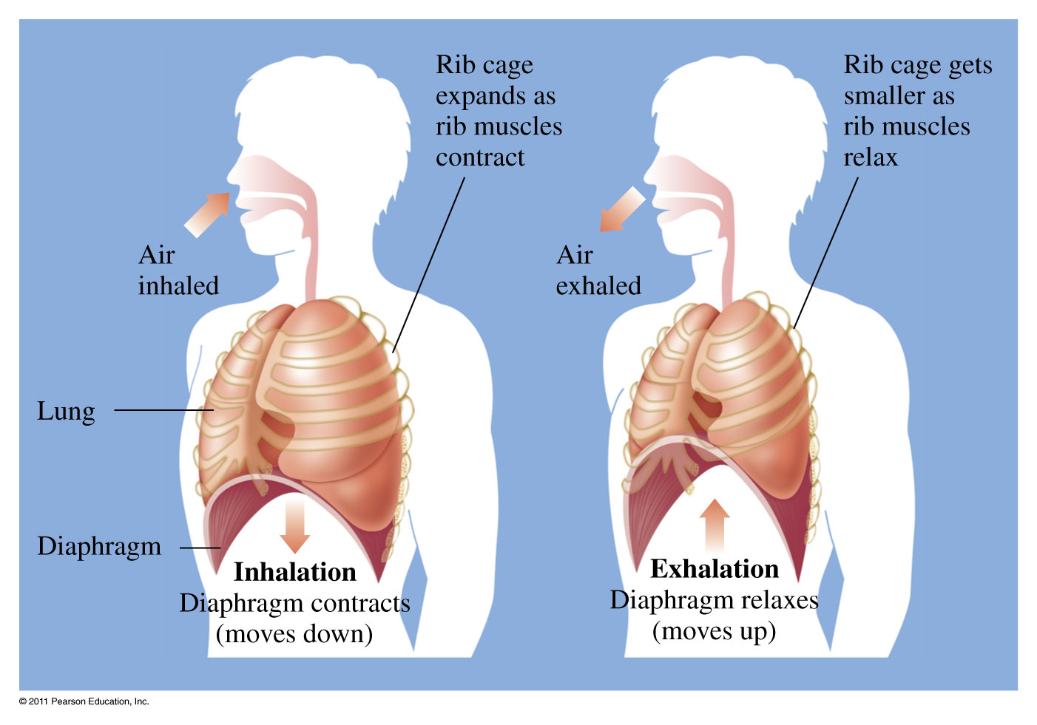
Avogadro’s Law
Volume is proportional to moles

Slide 13
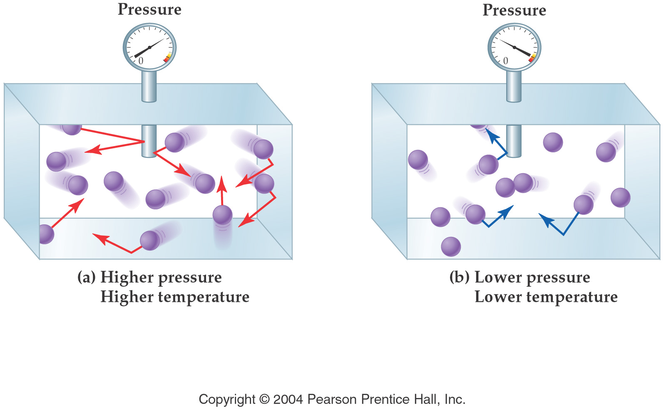

Slide 14
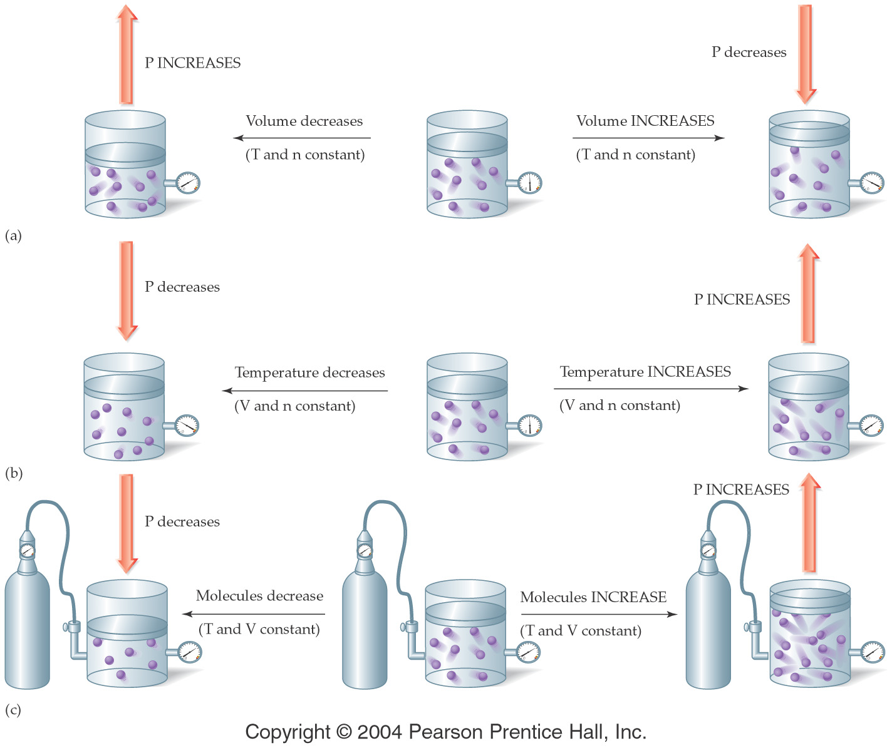

Slide 15
The Gas Laws
Boyles Law pressure ⇑ -- volume ⇓
P ∝ 1/V
Charles Law temperature ⇑ -- volume ⇑
V ∝ T
Avogadros Law moles ⇑ -- volume ⇑
V ∝ n
Gay Lussac Law temperature ⇑ -- pressure ⇑
P ∝ T

Slide 16
Ideal Gas Law
PV = nRT
P = pressure (typical units are atm or torr or mm Hg)
V = volume (typical units are L)
n = number of moles
T = temperature (must be in K)
R = gas constant = 0.0821 L atm/mol K
= 62.4 L torr/mol K

Slide 17
An inflated balloon has a volume of 0.55 L at sea level (1.0 atm) and is allowed to rise to a height of 6.4 km, where the pressure is about 0.40 atm. Assuming that the temperature remains constant, what is the final volume of the balloon?

Slide 18
A container of 452 mL of argon is heated from 22ºC to 187ºC at constant pressure. What is its final volume?

Slide 19
A bicycle tire has a pressure of 2000. torr in Death Valley when the temperature is 38ºC. What would the pressure be if you took the bike to Lake Tahoe where the temperature was 0ºC?

Slide 20
A small bubble rises from the bottom of a lake, where the temperature and pressure are 8ºC and 6.4 atm, to the surface, where the temperature and pressure are 25ºC and 1.0 atm. Calculate the final volume of the bubble if its initial volume was 21 mL.

Slide 21
Sulfur hexafluoride (SF₆) is a colorless, odorless, very unreactive gas. Calculate the pressure (in atm) exerted by 1.82 moles of the gas in a steel vessel of volume 5.43 L at 69.5ºC.

Slide 22
A sample of nitrogen gas kept at 32ºC in a 2.3 L container exerts a pressure of 4.7 atm. Calculate the number of moles of gas present.

Slide 23
Calculate the volume in liters occupied by 7.40 g of CO₂ at 735 torr and 25ºC.

Slide 24
Helium-filled balloons are used to carry scientific instruments high into the atmosphere. Suppose that a balloon is launched when the temperature is 22.5ºC and the barometric pressure is 754 mm Hg. If the balloon’s volume is 4.19 x 10³ L, what will it be at a height of 20 miles, where the pressure is 70.0 mm Hg and the temperature is −33.0ºC?

Slide 25
Chlorine is widely used to purify municipal water supplies and to treat swimming pool waters. Chlorine is stored in stainless steel cylinders of 30.0 L capacity at a pressure of 160 lb/in² at 26ºC.
To what temperature may the cylinder be raised if it is rated to a maximum pressure of 5.35 atm? 14.7 psi = 1 atm

Slide 26
Standard Temperature and Pressure (STP)
T = 0ºC = 273K, P = 1 atm. = 760 torr
Calculate the volume of 1.0 mole of a gas at STP.
What volume will 3.21 moles of Ne occupy at STP?

Slide 27
A 3/4 full propane tank has a pressure of 3.2 atm at a temperature of 25ºC. If you put the tank in the back of your car for a barbecue at the beach and the temperature reaches 103ºC, what is the new pressure of the propane in the tank?

Slide 28
What volume will 4.83 moles of a gas occupy at 35ºC and 1.15 atm pressure?

Slide 29
Find the molar mass of an unknown gas that has a density of 1.45 g/L at 44ºC and 0.331 atm.

Slide 30
The nitrogen gas in an air bag with a volume of 35 L, exerts a pressure of 850 mm Hg at 25ºC. How many grams of N₂ are in the bag?

Slide 31
Calculate the density of Argon at STP.

Slide 32
Gas Stoichiometry
C₃H₈(g) + 5 O₂(g) → 3 CO₂(g) + 4 H₂O(g)
How many mL of CO₂ can be generated from the reaction of 5.00 g C₃H₈ with excess oxygen at STP?
How many L of O₂ are required to react with 4.22 L of C₃H₈ at constant Tand P?

Slide 33
Daltons Law of Partial Pressures
P_{total} = P₁ + P₂ + P₃ + ......
the total pressure is equal to the sum of the pressures of the individual gases

Slide 34
The atmosphere of Venus contains the following gases.
CO₂ 392 torr,
N₂ 834 torr
Ar 302 torr
What is the atmospheric pressure on Venus?

Slide 35
Vapor pressure
the pressure that is exerted by a vapor that is in equilibrium with its liquid.

Slide 36
Often gases are collected over water and the vapor pressure of the water must be subtracted from the total pressure to find the pressure of the gas collected.

Slide 37
Boiling point
the temperature at which the vapor pressure is equal to the atmospheric pressure.

Slide 38
Graham's Law
Allows us to calculate relative rates of effusion for various gases.
Effusion - The escape of a gas through a small hole in its container.
Diffusion - The process by which two or more gases begin to mix together.
Graham's law says that the heavier a particle is (higher MW) the more slowly it will effuse or diffuse under the same conditions.

Slide 39
Kinetic Molecular Theory
Gases consist of molecular particles moving in straight lines at any given instant.
Gas molecules are widely spaced, the actual volume of molecules is negligible compared to the space they occupy.
Gas molecules demonstrate rapid motion, move in straight lines and travel in random directions. When they collide with each other they do so with no net loss of energy.
Gas molecules behave independently -- attractive/repulsive forces between them are negligible.
The average kinetic energy of the gas particles is proportional to the temperature.

Slide 40
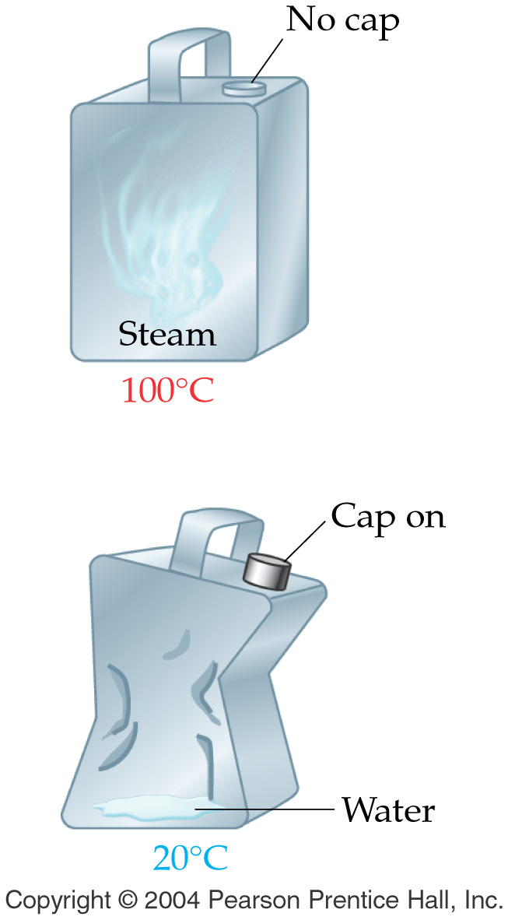
Key Concepts
A few drops of water in a metal can are heated to steam and the can is promptly sealed. As the steam cools from 100ºC to 20ºC, the can is crushed as shown in the diagram. Explain the observation.

Slide 41
